Slide 1


EXECUTIVE DATA ANALYSIS REPORT PROJECT: COFFEE CUP (2019) INVENTORY AND SALES ANALYSIS
PREPARED BY:
DEBOPRIYA DATTA (100997901)
RIVAN JOSE (100992168)
DRASHTI MAKWANA(100995859)

Slide 2


OBJECTIVE
COFFEE CUP
Examine the 2019 Coffee Cup data in order to:
Gather information on sales and profits.
Determine which areas or goods are functioning well and which are not.
Find holes in the quality of the data Make suggestions for future data improvements.
Create an executive dashboard that is in line with your plan.

Slide 3

ABOUT THE DATASET
$250,000
65%
100
$180,000
Total Sales
Profit Margin
Average Monthly Sales
Highest Revenue
ESPRESSO

Slide 4




DATA QUALITY ASSESSMENT
Duplicates
Missing Values
Standardization
Conclusion

Slide 5



QUESTIONS ANSWERED BY THE DATASET
DATA GAPS IDENTIFIED
Which market is most profitable?
Which provinces contribute the most to profit?
How to actual sales compare to budgeted sales?
What are the best-selling product types?
How does inventory align with margin across products?
Customer Demographics.
Sales Channel Info.
Stock Turnover Metrics.
Time-Stamped Transactions
QUESTIONS THE DATASET CANNOT ANSWER
Customer segmentation and preferences.
Performance of online vs in-store channels.
Marketing campaign effectiveness and ROI.
Inventory turnover and stockout tracking.

Slide 6
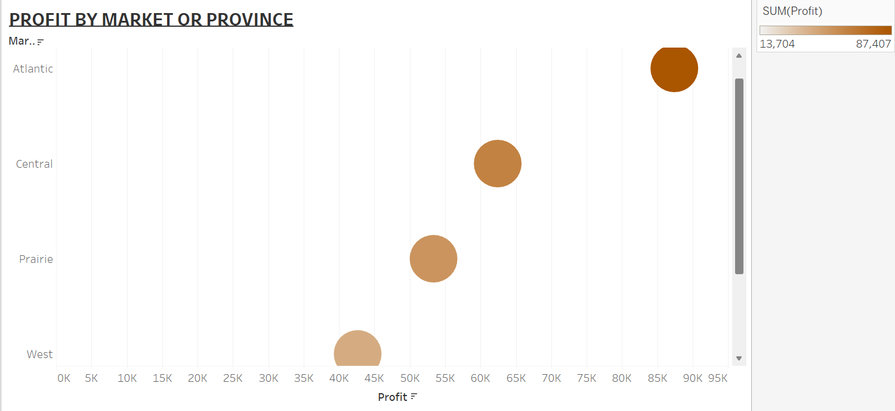
1st visualization of the dataset

Slide 7
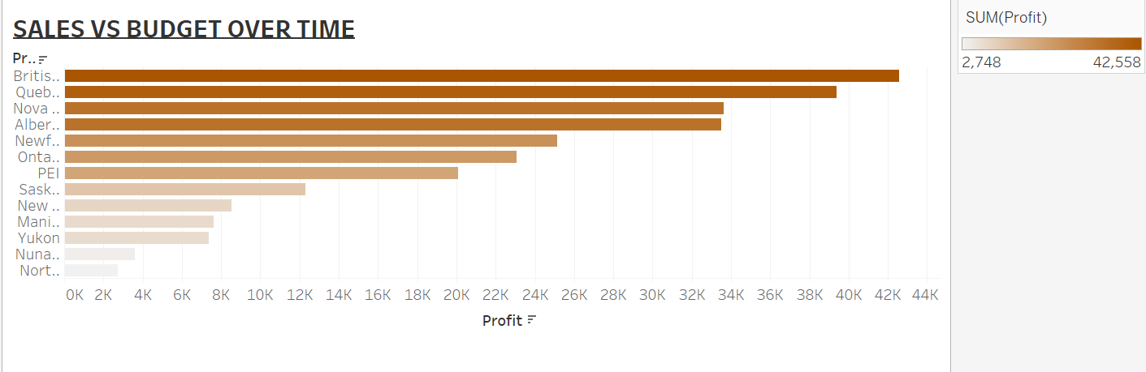
2nd visualization of the dataset

Slide 8
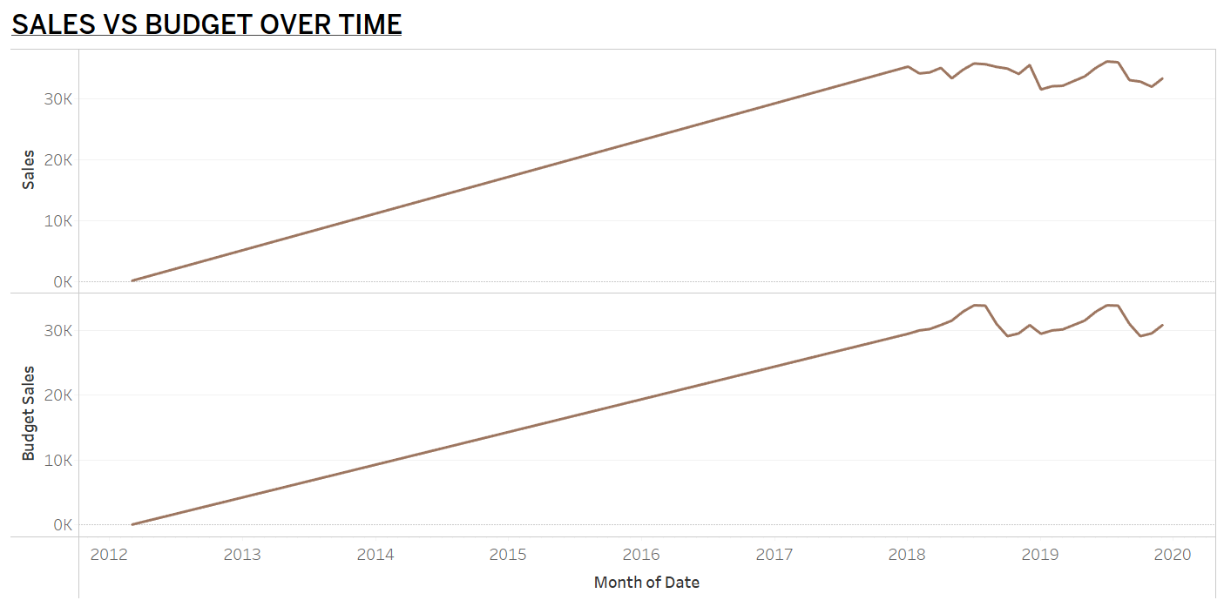
3rd visualization of the dataset

Slide 9
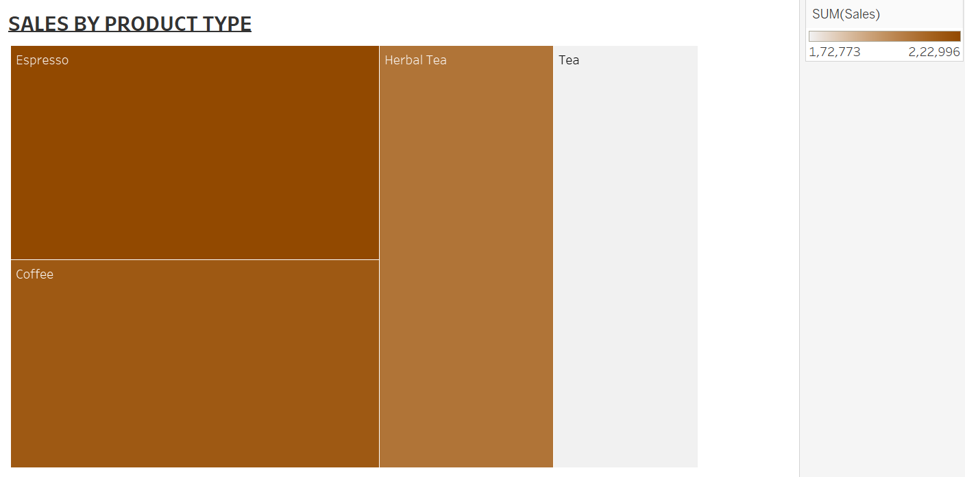
4th visualization of the dataset

Slide 10
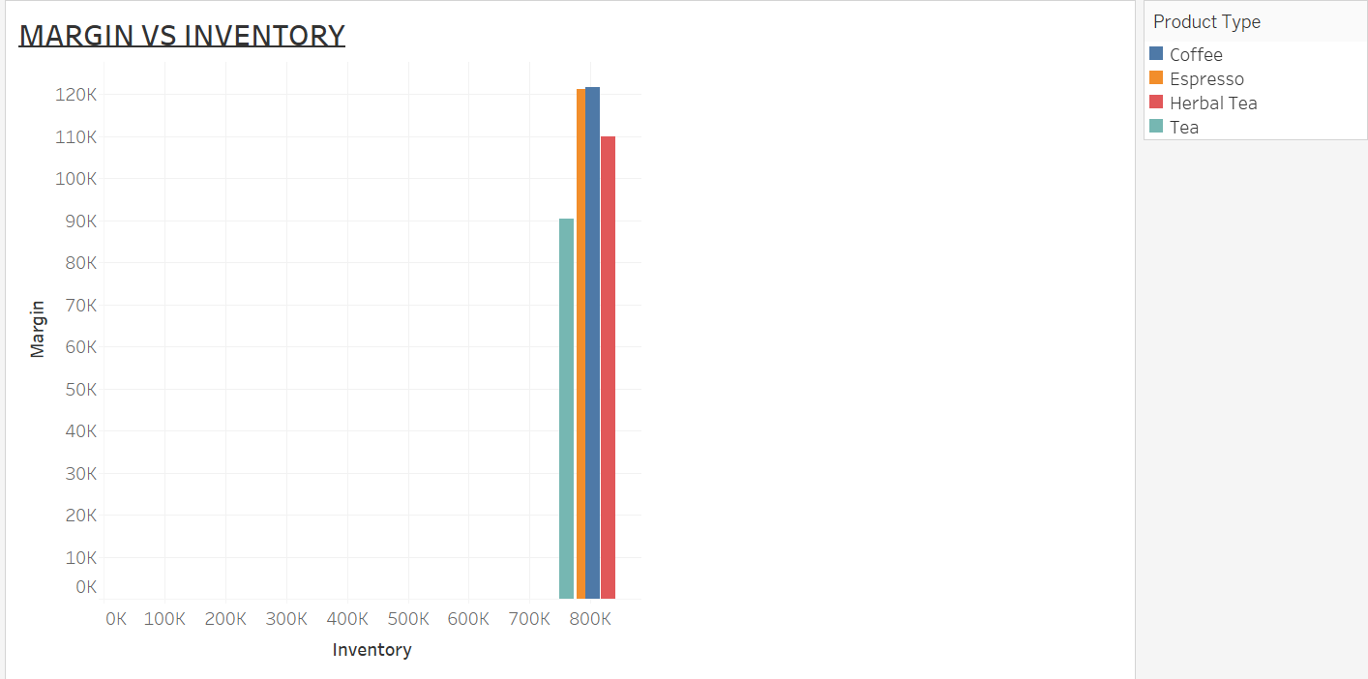
5th visualization of the dataset

Slide 11
DASHBOARD DESIGN SUMMARY
Profit by Market (Bubble Chart): Indicates areas with strong and weak performance.
Monthly Comparison of Sales and Budget (Line Chart) across Time.
Treemap Sales by Product Type: A fast overview of the most popular categories.
Bar Chart of Margin vs. Inventory: Matches ROI with Stock Levels.

Slide 12

STRATEGIC BUSINESS INSIGHTS
High profit centers are found throughout West and Central Canada.
Tea is underperforming; there may be a problem with pricing or advertising.
Regular budget overperformance indicates the need to update goals.
Profit-aligned inventory for Espresso & Coffee

Slide 13
BUSINESS RECOMMENDATIONS FOR 2020
Increase the scope of data collecting to include demographics, transactions, and campaigns.
Every quarter, audit and standardize the master dataset.
Create marketing plans based on performance data.
Install real-time dashboards at the regional and retail levels.

Slide 14

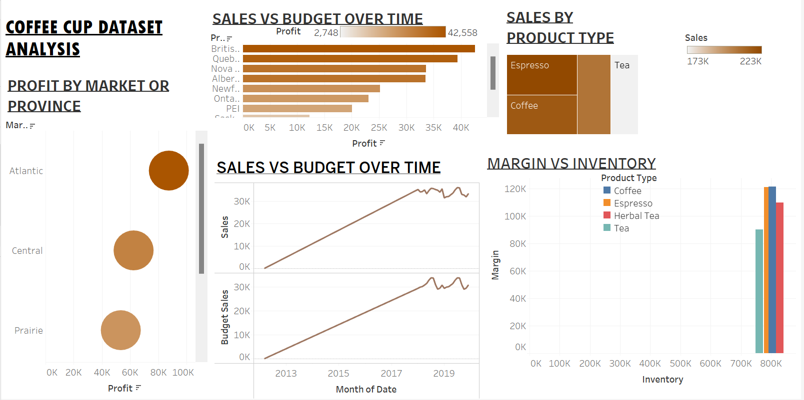
Thank you

